Slide 1
Deloitte Capstone
Final Presentation
Part 1: Business Presentation
November 18, 2022

Slide 2





Project Team
Vikram Kharvi
MSAI
Eloka Obi
MSAI
Neel Karpe
MBAi
Tianyi He
MBAi
Jake Reiner
MBAi

Slide 3
Agenda
Background and Scope
Data + Analysis Description
Three Key Analyses:
Customer Segmentation
Channel Trends
Sector Shift
Next Steps

Slide 4

Our project will help Deloitte in 3 broad areas
Overall: Extend Deloitte’s InsightIQ Analytics Offering to automate consumer spending analysis for retail industry
Develop Capabilities
Serve Clients Better
Differentiate
Enhance the analytics expertise in-house and build reusable tools to discover insights for the retail industry
Use the tools and insights developed to provide exceptional service and improve client relationships
Continue to build capabilities as a competitive advantage to establish thought leadership in the industry
Notes:
Extend Deloitte’s InsightIQ Analytics Offering to automate consumer spending analysis for retail industry
Draw insight from various data sources
Develop reusable tools for repeatable analysis / reports

Slide 5
We distilled the guiding questions into 3 key questions for analysis
Original Guiding Question
Question for Analysis
Key Datasets + Variables
What kind of customers are driving changes in performance (e.g. drop in spend)?
Backward looking: which customer segments have been decreasing total spend?
TOTAL SPEND - Credit & Debit
Customer attributes variables - Consumer Behavior and Lifestyle data
1
How do these behaviors vary by channel (online vs. offline)?
Backward looking: how significant is channel as a factor for the decrease in spend?
TOTAL SPEND - Credit & Debit
CHANNEL - Credit & Debit
2
What sectors is customer spend shifting to?
Forward looking: which sectors will see increased spend?
TOTAL SPEND - Credit & Debit
SECTOR, SUBSECTOR - Credit & Debit
3

Slide 6
Key Dataset Overview
Dataset Name
Key Variables
Spending data including:
Total spend
Sector, subsector
Week
1
Credit & Debit Card Spend Data
xx
2
Consumer Behavior & Lifestyle Data
Various consumer behavior details including:
Income, job
Demographic, household size
Spending habits
3
Financial Health Data
Credit usage information including:
Credit score
Income group
Zip code

Slide 7




Data Analysis Summary
Cleaning and Stacking
datasets
A
Merging datasets (credit, consumer, financial health)
B
C
Exploratory & Descriptive analysis:
segmenting spend by various features
D
Predictive analysis: ARIMA model, multivariate linear regression

Slide 8
What kind of customers are driving changes in spending?
1

Slide 9
Customer Segmentation Analysis
1
Oldest age brackets (55+) represent 53% of total spend
Average spend for 65+ segment is 1.5x the average for the youngest age brackets
Highest income brackets make up 67% of total spend; total and average spend are roughly similar for households with income <$100k

Slide 10
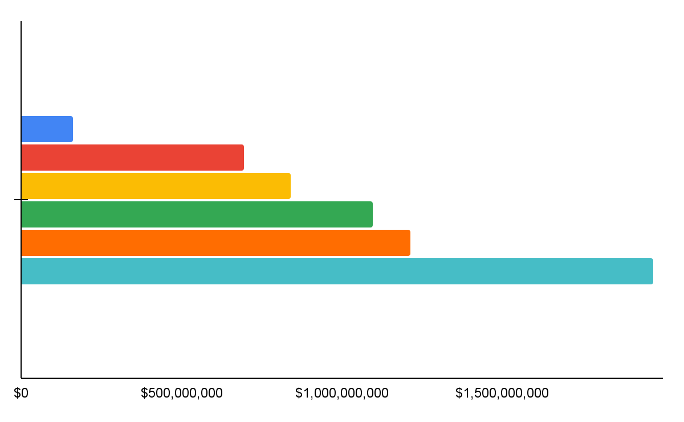
Older age groups largely dominate the total spend between 2019 and 2022
1
Total Spend by Age Bracket - Cumulative 2019-22
Takeaways
Total spend is consistently higher for each subsequent age bracket
The oldest 2 age brackets (55-64 and 65+) represent 53% of total spend across the time period
18-24
25-34
35-44
45-54
55-64
65+

Slide 11
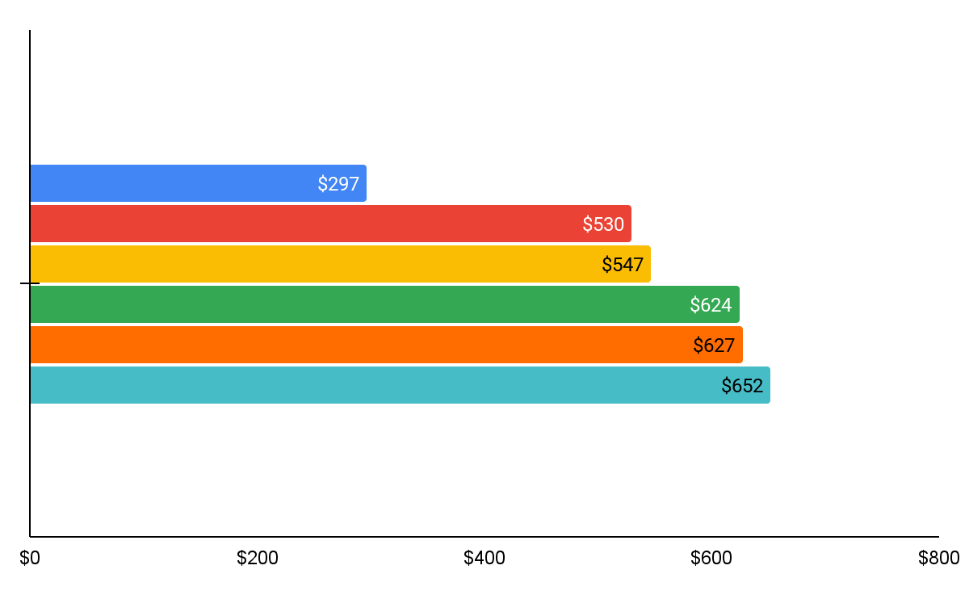
In addition to aggregate spend, older age groups also show more average spend per customer
1
Average Spend per Age Bracket
Takeaways
Average spend is consistently higher for each subsequent age bracket but the discrepancy is not as large as aggregate spend
The average spend for 65+ age bracket is ~1.5x the average spend of the youngest age bracket (18-24)
18-24
25-34
35-44
45-54
55-64
65+

Slide 12
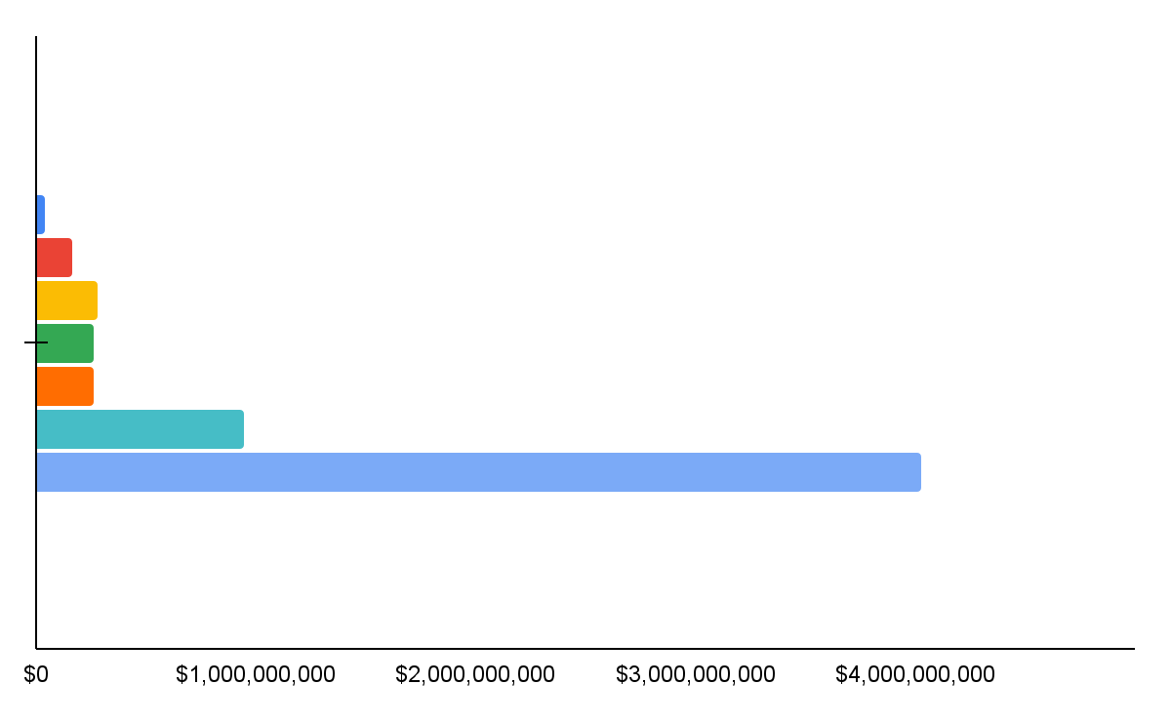
Total spend is dominated by largest income brackets but is similar for <$100k segments
1
Takeaways
Total spend is within a similar range for incomes between $20k and $100k annually
The highest income brackets make up the vast majority of total spend; especially the $150k+ segment making up 67% of total spend
Total Spend by Income Bracket - Cumulative 2019-22
<$20k
$21-40k
$41-60k
$61-80k
$81-100k
$101-150k
$150k+

Slide 13
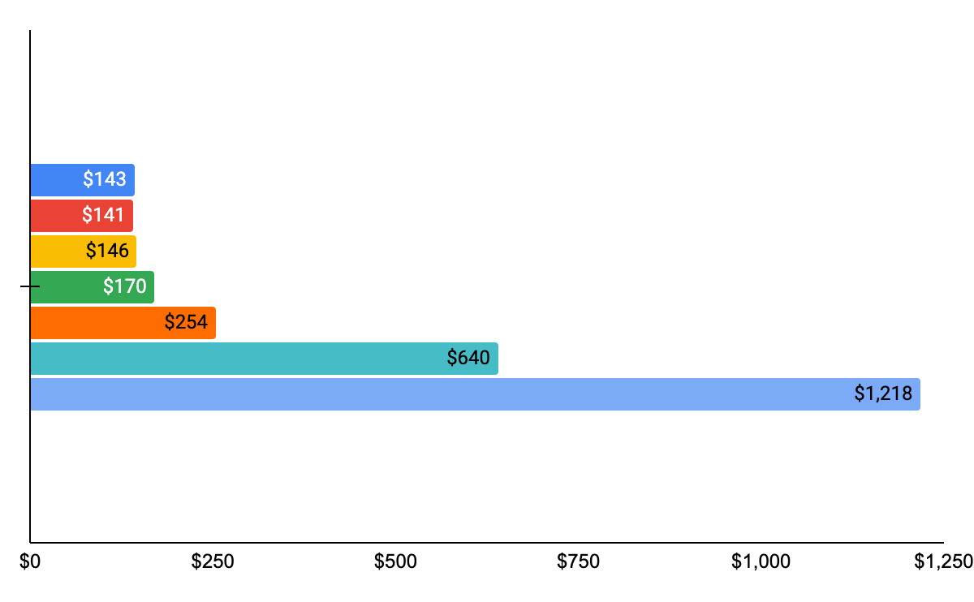
Average spend shows similar patterns but the difference between largest brackets is smaller
1
Average Spend per Income Bracket
Takeaways
Similar to aggregate total spend, segments below $100k show roughly similar levels of spend
The discrepancy between the $101-$150k and $150k+ segments (the 2 highest income segments) is not as high as in aggregate spend
<$20k
$21-40k
$41-60k
$61-80k
$81-100k
$101-150k
$150k+
Notes:
Average may be skewed especially for lowest and highest income brackets, Fin data of individual

Slide 14
Total Spend by Income Bracket
Average Spend by Income Bracket
<$20k
<$20k
$21-40k
$21-40k
$41-60k
$41-60k
$61-80k
$61-80k
$81-100k
$81-100k
$101-150k
$101-150k
$150k+
$150k+

Slide 15
How do these behaviors vary by channel (online vs. offline)?
2

Slide 16
Channel Trends
2
Offline spend still a significant proportion of total spend - ~45%
Online spend has been growing faster - increased from ~50% of total in 2019 to ~55% in 2022; some signs of plateauing as % of total spend
Online spend shows greater seasonality than offline spend

Slide 17
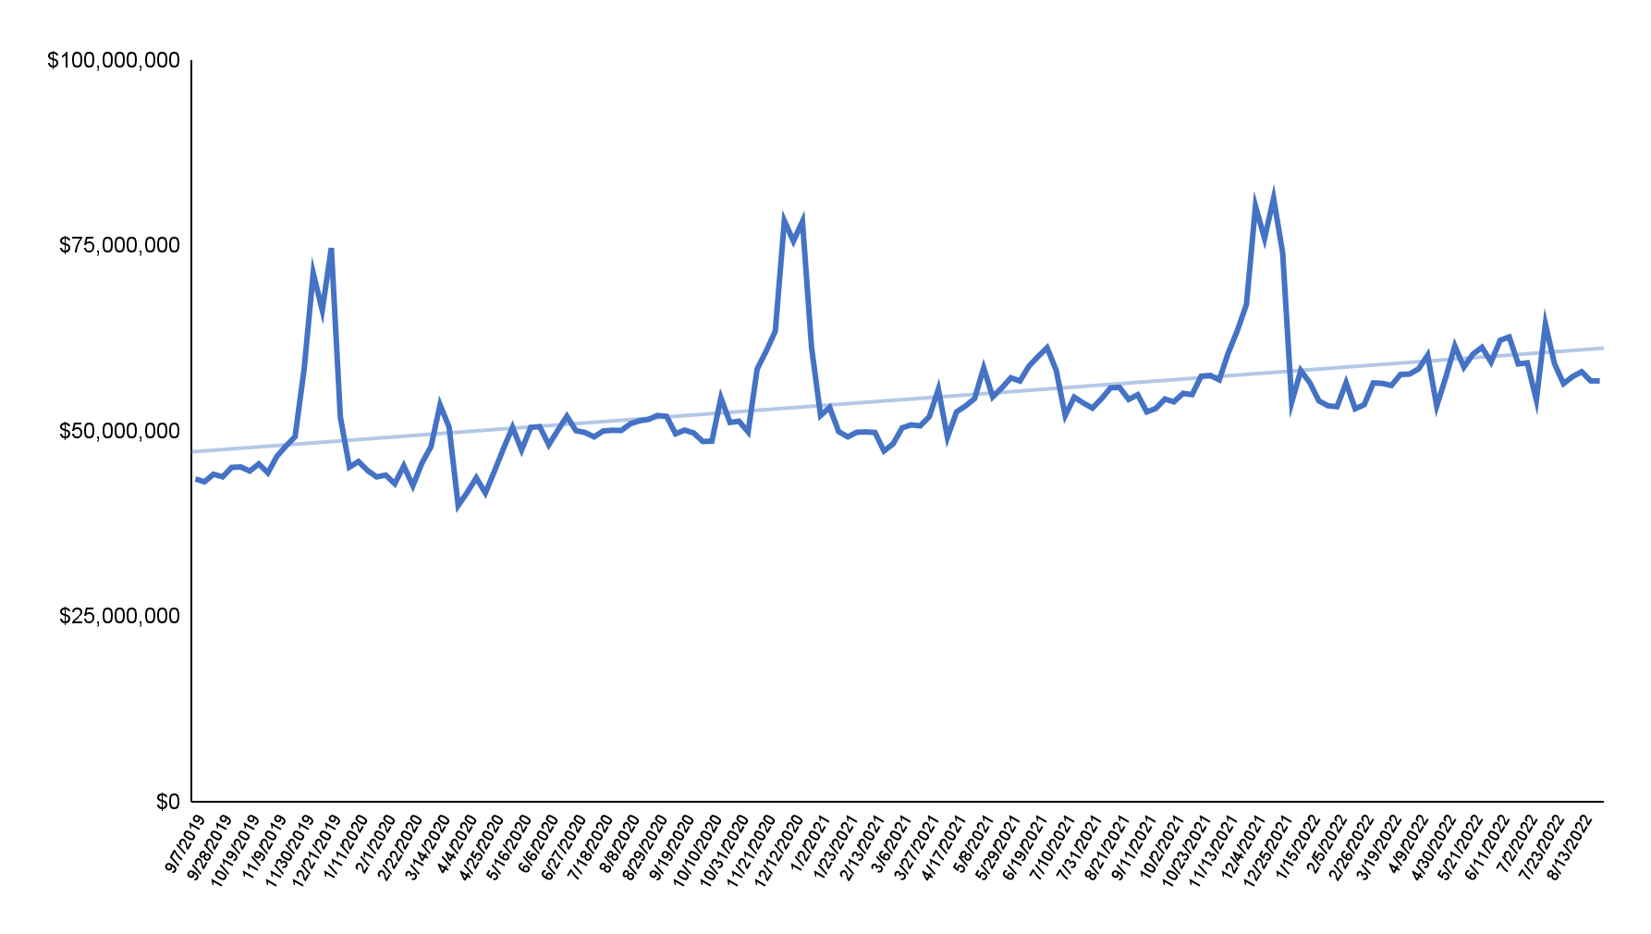
Total spend has been increasing gently over time with predictable peaks at the end of each year
2
Time Series of Total Weekly Spend (2019 - 2022)
Takeaways
Trendline indicates that total spend has been increasing at a gentle pace over 2019-22
Spending each year predictably peaks near the end of the year - coinciding with Thanksgiving (Black Friday) and Christmas
Note: Inflation not accounted for.
Notes:
inflation flag (done)

Slide 18
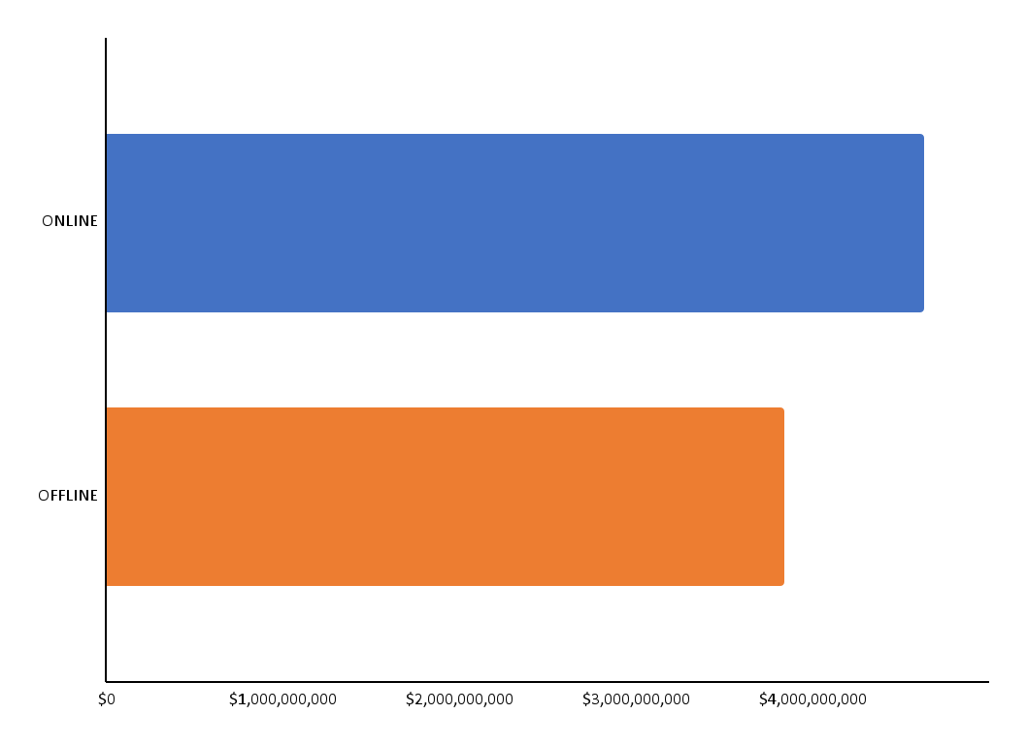
Online spending has represented ~55% of cumulative historical spend
2
Takeaways
Total Spend by Channel - Cumulative 2019-22
At an aggregate level, both channels are significant - representing $3.5B+ spend each
Online spending has accounted for ~55% of total spend over the last few years
Online
$4.6B
Offline
$3.8B

Slide 19
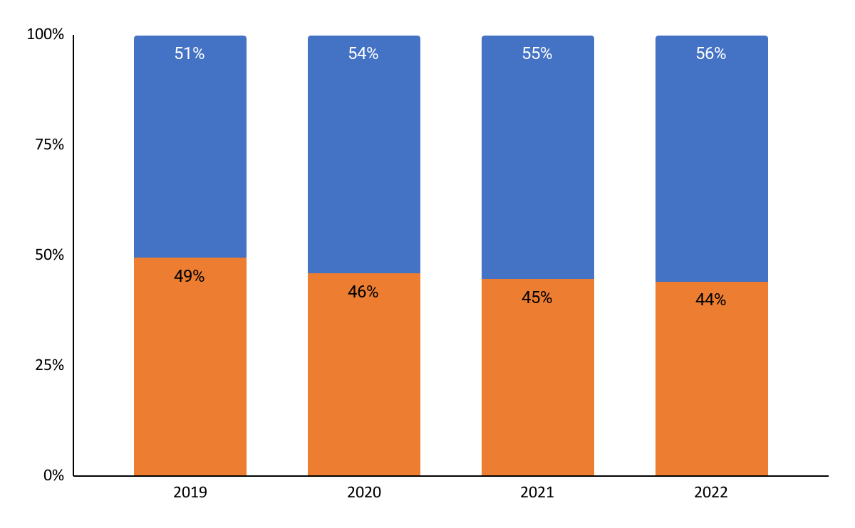
Online % of total spend has increased since 2019 but appears to plateauing at ~55%
2
Takeaways
Online vs Offline % of Total Spend by Year
Online spend has increased from ~50% to ~55% of total spend from 2019 to 2022
Growth of online as % of total spend has appeared to flatten since 2020 (the rapid increase likely due to COVID effects)
Online
Offline

Slide 20
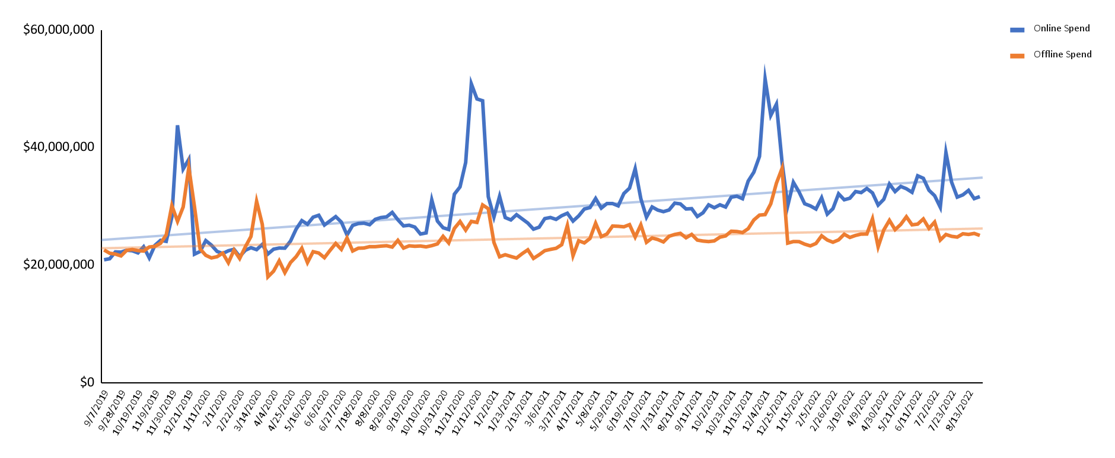
Online spend, which appears to show greater seasonality, has been growing faster than offline
2
Time Series of Total Weekly Spend by Channel (2019 - 2022)
Takeaways
Online spend has been growing faster than offline spend - represented by the steeper trendline
Online spend appears to be more seasonal - with greater spikes in spending at the end of each year
Online
Offline
Notes:
compare growth rates of each to inflation rate?
online seasonality starts earlier

Slide 21
What sectors is customer spend shifting to?
3

Slide 22
Sector Shift Analysis
Mass and grocery sectors collectively represent over 50% of total spend
Based on predictive modeling, the hotel and airline sectors are forecast to grow the fastest

Slide 23
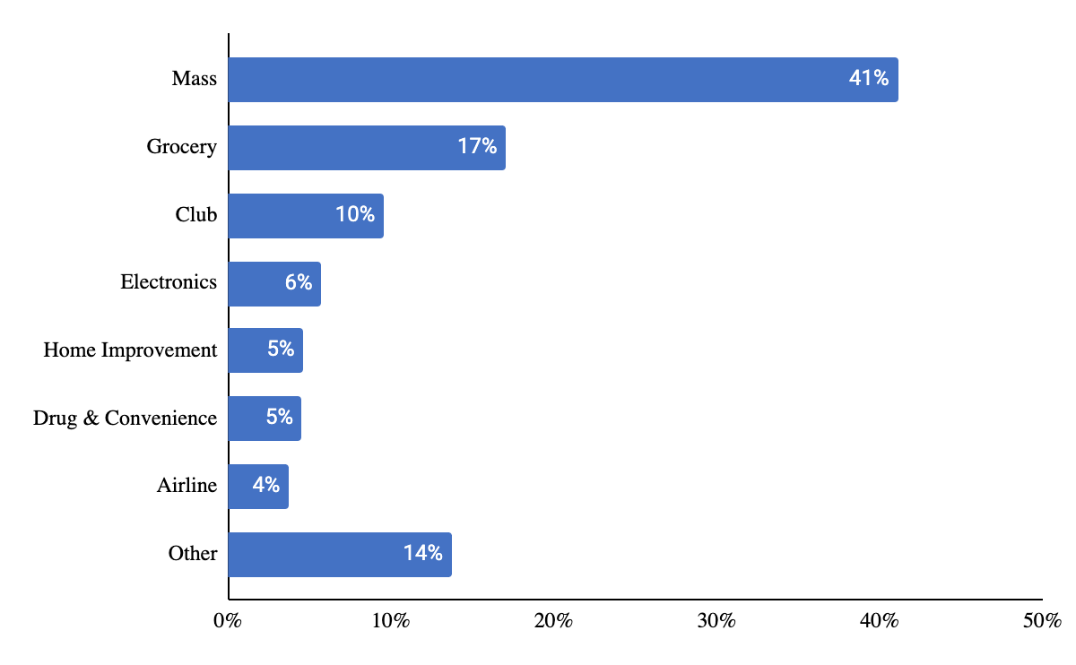
Mass and grocery represent greater than 50% of total spend, with a long tail of sectors
3
Takeaways
Total Spend by Sector (%) from 2019-21
Mass and Grocery segments collectively account for 58% of total spend
A long tail of 12 sectors represent the “Other” category including footwear, car rentals, sporting goods, etc.
Specialty Stores (Other)
Notes:
Change Other to speciality stores (done)

Slide 24
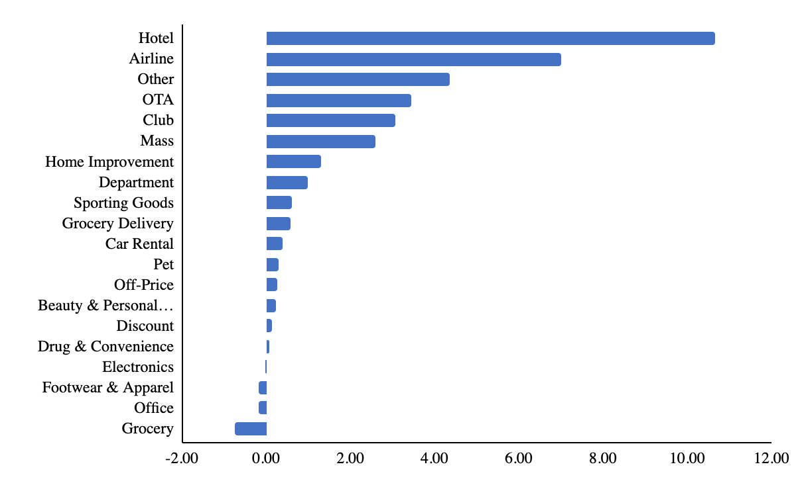
Based on predictive modeling, the hotel and airline sectors are forecast to grow the fastest
3
Takeaways
Predicted Regression Slope by Sector
(Indicator of Future Growth)
Based on the predictive regression model, hotels and airlines are likely to grow the fastest over the next few years
Results of the regression should be updated and monitored in post-COVID world
Notes:
Change Other to speciality stores (done)

Slide 25
Next Steps
Technical presentation in final week - detailed walkthrough of analysis and modeling
Additional analysis as a supplement - visitor count + mobile data, interactive map and dashboard, financial health analysis
Transfer of code + analysis

Slide 26
Thank you!
Questions?

